Slide 1
Paper recap: On the Measure of Intelligence - François Chollet
Presentation by Son Ha
For the Czodrowksi Lab 5 mins of fame

Slide 2
Aim of the recap
64 pages paper! Very detailed and nuanced.
Not go into details, only to hook you in.
TL,DR:
How was human intelligence previously defined/measured in AI?
What are the pitfalls of previous definitions?
What does the author propose as a new definition of intelligence?

Slide 3
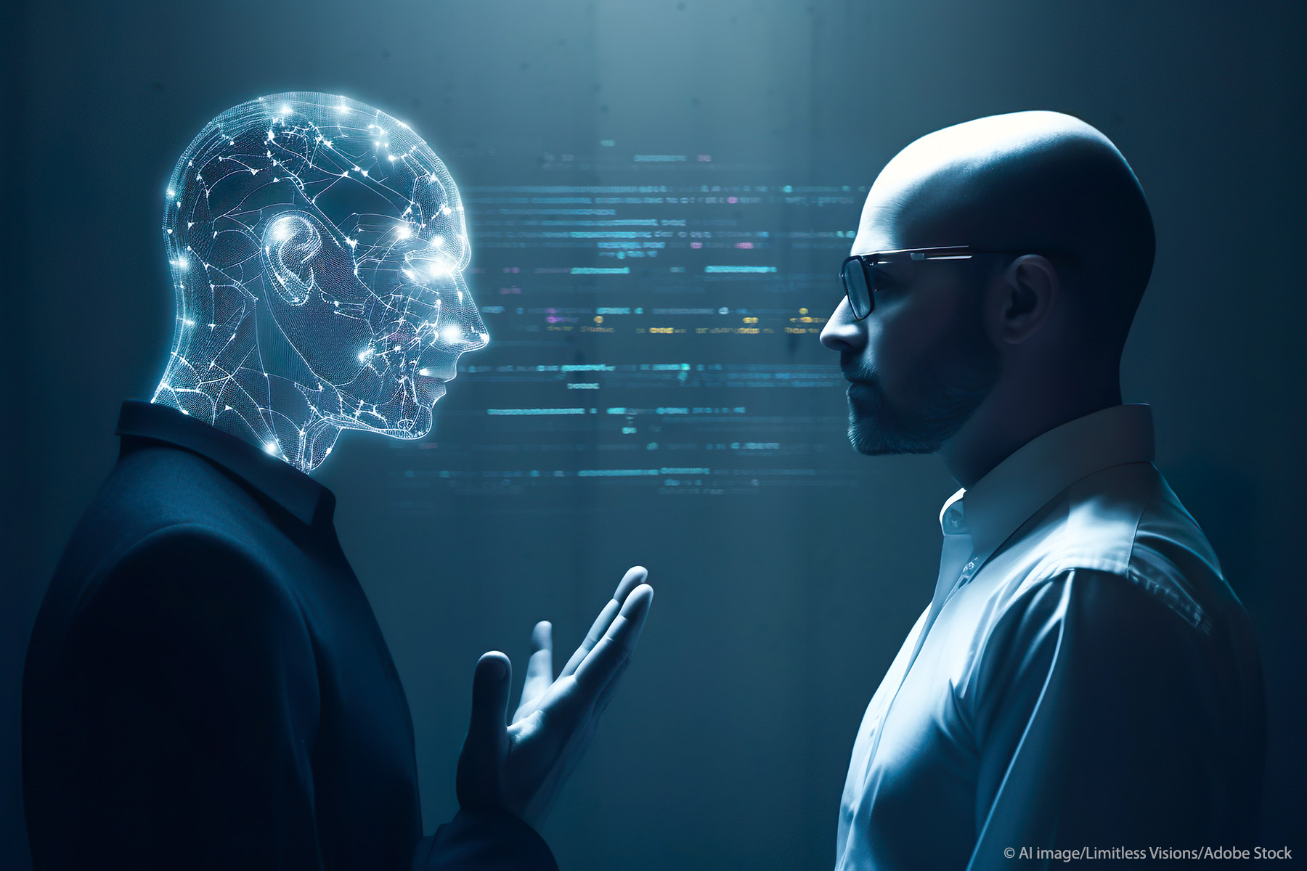
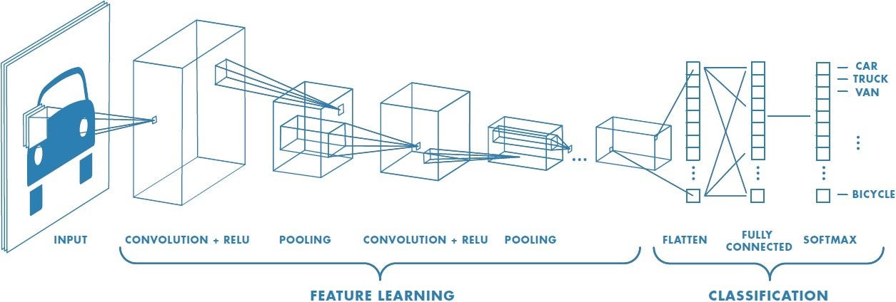
Need for an actionable definition and measure of intelligence
Promise of AI: Develop machines that possess intelligence comparable to humans.
Reality: Highly specialized AI, data-hungry, failed to generalized beyond training set and priors,…
Reason:
Little attention devoted to define/evaluate/benchmark intelligence.
Current definitions are implicit + riddled with decade-long biases.
We have not explicitly defined ‘human intelligence’, let alone building human-like AI

Slide 4
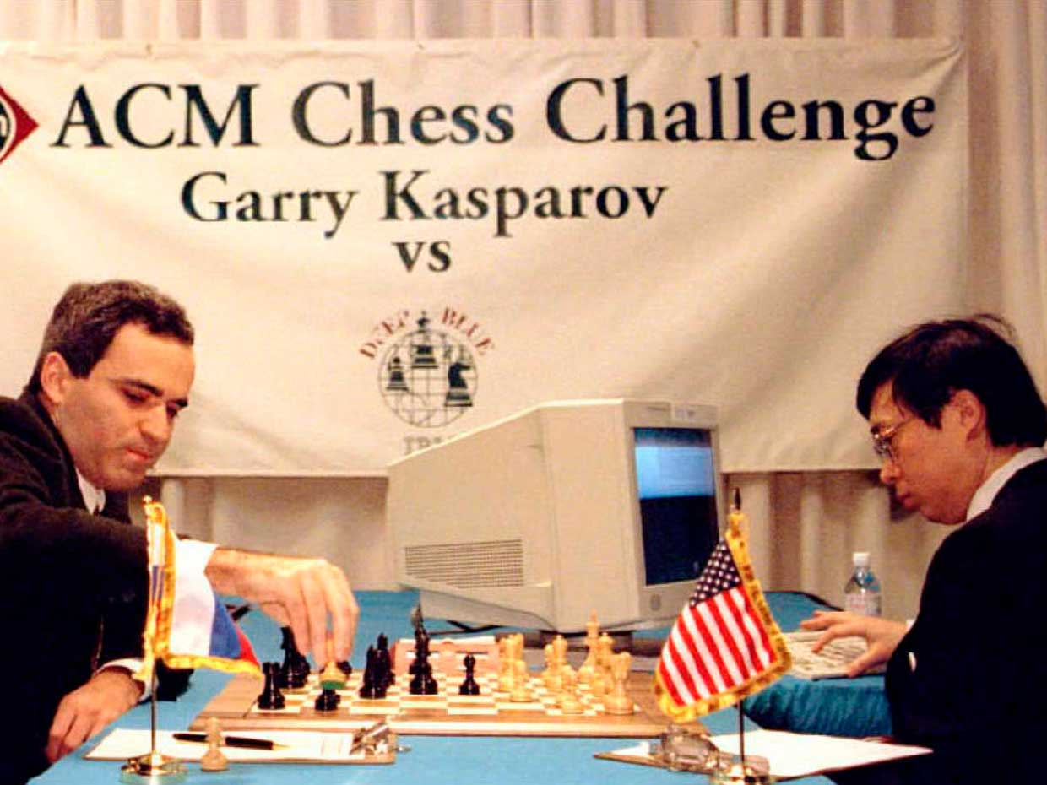
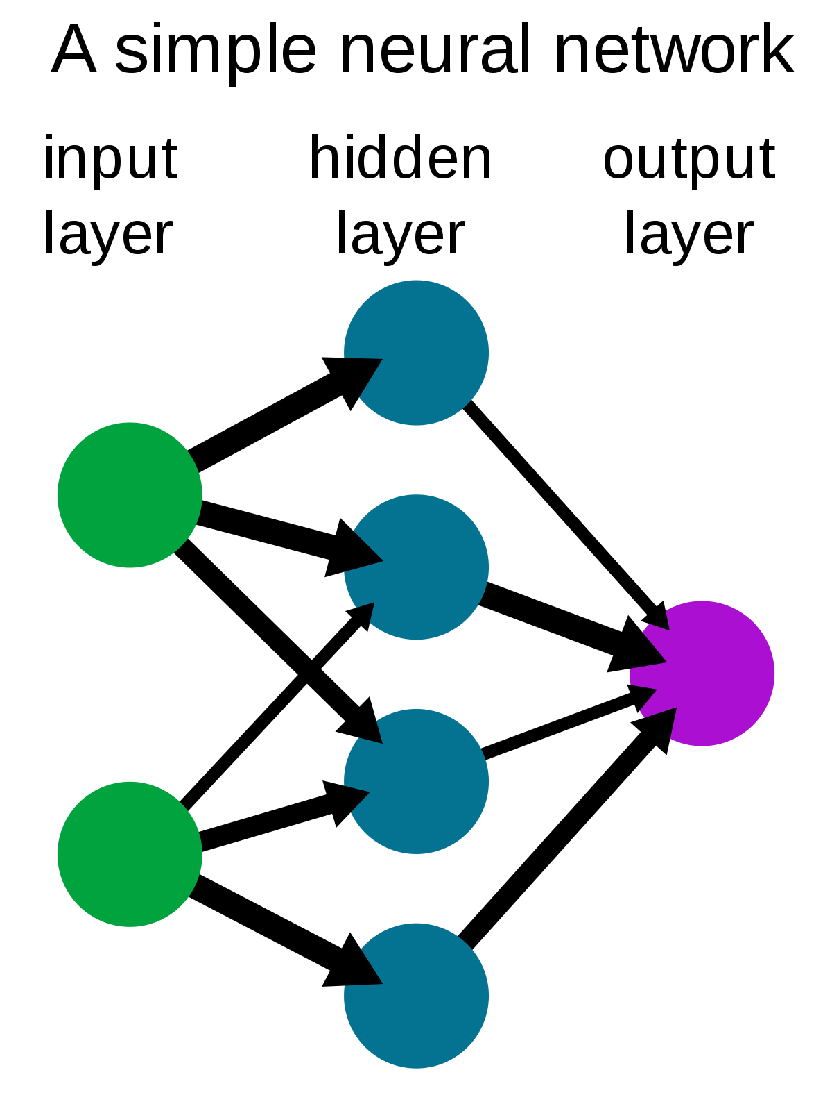
Defining intelligence: two divergent visions
Intelligence as a collection of task-specific skills
Charles Darwin: Human cognitive function is a result of skills learned to solve specific problems throughout their evolution.
Dominant view in early AI research (1950-70)
Intelligence as a general learning ability
John Locke: The mind is a Tabula Rasa (blank slate), flexible and highly adaptive. Turns experience (data) into skill.
Dominant view in modern machine learning
Randomly-initialized Neural Net is a Tabula Rasa, which can be trained to solve many problems.

Slide 5
Defining intelligence: two divergent visions
Intelligence as a collection of task-specific skills
Charles Darwin: Human cognitive function is a result of skills learned to solve specific problems throughout their evolution.
Dominant view in early AI research (1950-70)
Intelligence as a general learning ability
John Locke: The mind is a Tabula Rasa (blank slate), flexible and highly adaptive. Turns experience (data) into skill.
Dominant view in modern machine learning
Which of these views is correct when it comes to human intelligence?
Randomly-initialized Neural Net is a Tabula Rasa, which can be trained to solve many problems.

Slide 6
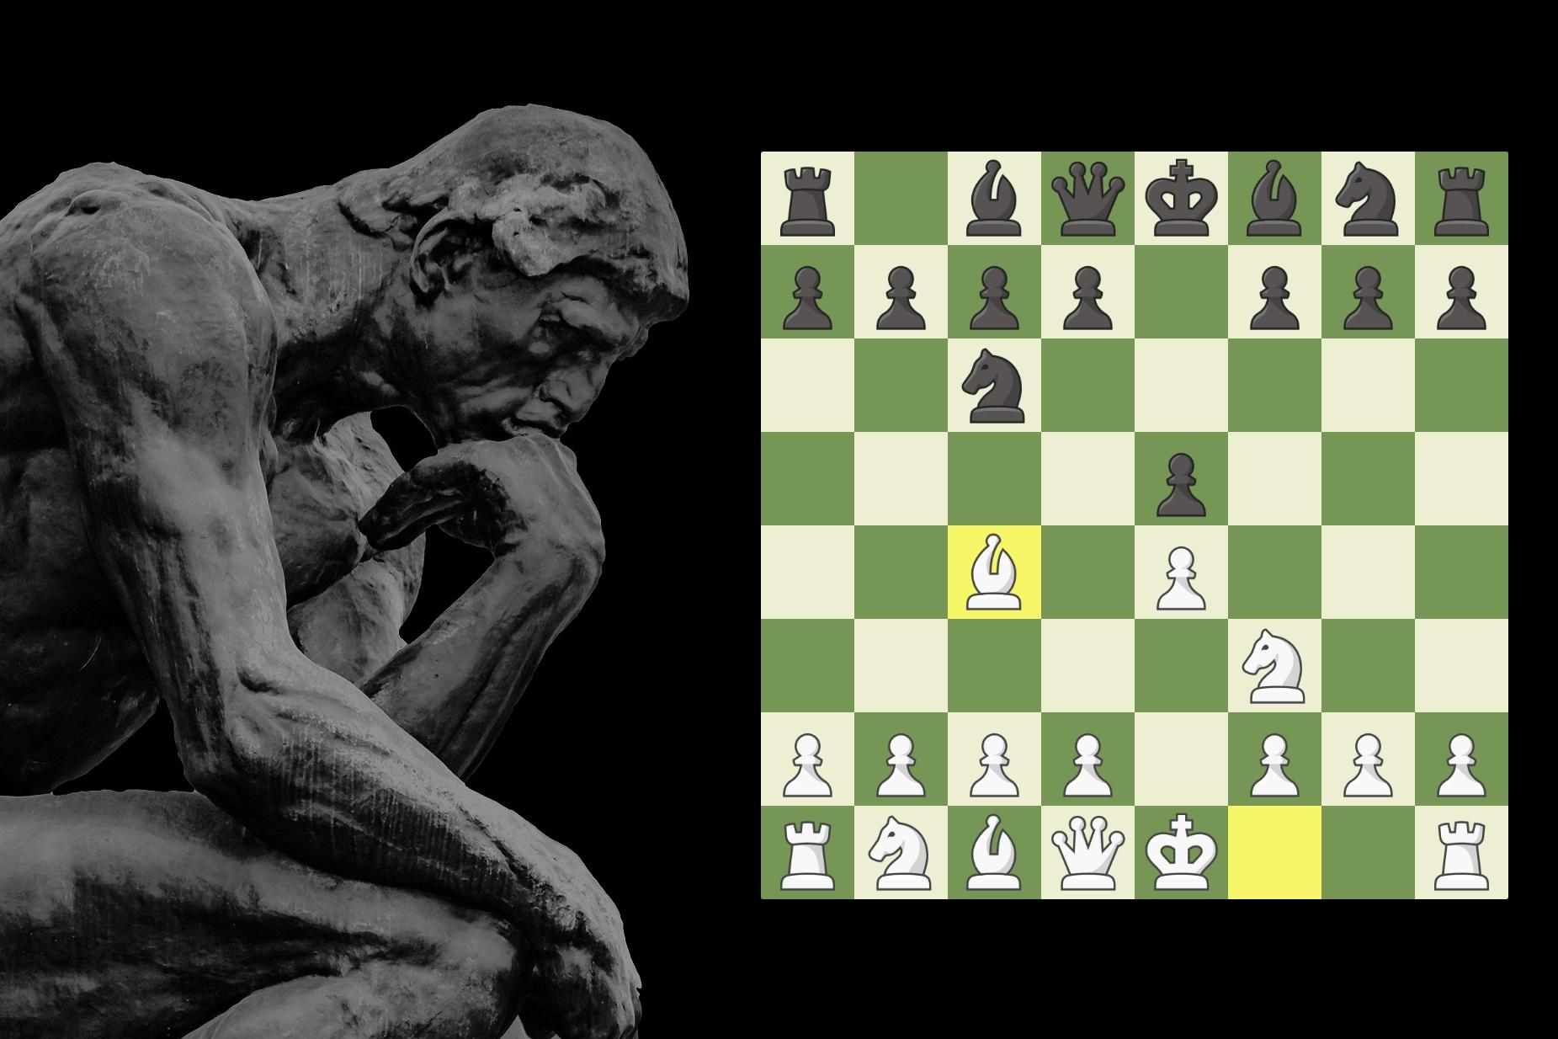
Pitfalls
Intelligence as a collection of task-specific skills
Case study: DeepBlue and chess
Assumption: Chess involves complex human abilities (planning short-term, long-term, means-end analysis,…) → If we can build AI that play chess, we can understand these human abilities.
Reality: Just a chess bot, we learned nothing about human intelligence.
Why? Skill is not human intelligence. Machine takes shortcut that is orthogonal to human cognition.

Slide 7
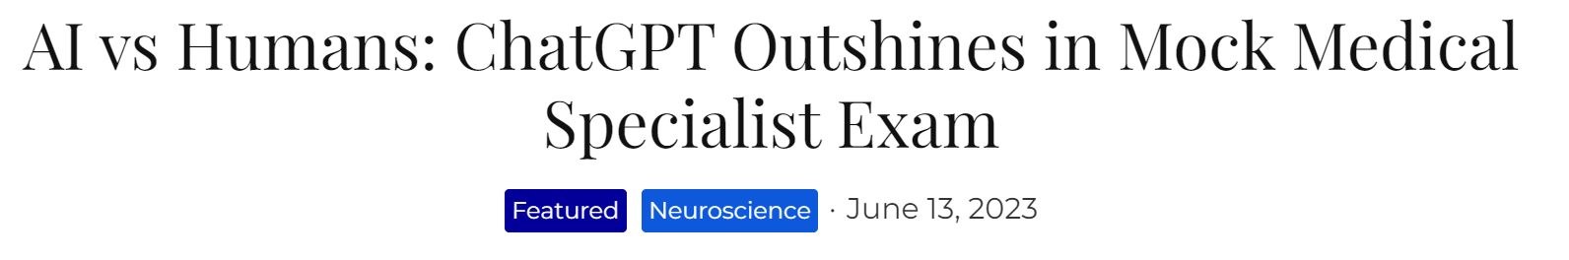
Pitfalls 2
Intelligence as a general learning ability
Is learning from a ton of data considered ‘intelligence’?
Mini Case Study: ChatGPT
Performs well in some exams
BUT trained on THE ENTIRE INTERNET!
Artificially “buy” performance just by adding more training data. Not ensure generalization.
Is it sensible to define intelligence this way? We can do better!

Slide 8
Improving previous notions
The author argues these points:
…
Intelligence lies in broad or general-purpose abilities; it is marked by flexibility and adaptability rather than skill itself.
A measure of intelligence should imperatively control for experience and priors, since unlimited experience and prior can lead to little generalization power
…

Slide 9
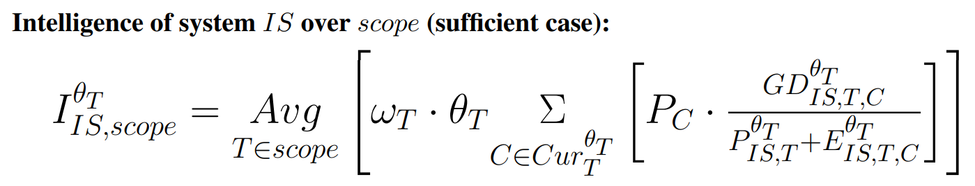
A new definition of ‘intelligence’
Dev-aware
Generalization
Difficulty
Average over
all scopes
Average over
all curriculum
Prior + Experience
In simple words: A system is intelligent if it can turn little prior knowledge and little training into new skills for different complex tasks.

Slide 10
New definition fixes old pitfalls
A system is intelligent if it can turn little prior knowledge and little training into new skills for different complex tasks.
Take prior and experience into account
Adaptability and flexibility

Slide 11
Takeaways
The author has introduced a new perspective on defining and evaluating intelligence.
The study of general artificial intelligence is a field still in its infancy.
Still much room for improvements
In addition to developing specialized AI, general (human-like) AI is also a field worth a lot of attention.

